Slide 1
Building External DSLs
Jimmy Bogard
@jbogard
jimmy@headspring.com

Slide 2
What is a DSL?
A computer programming language of limited expressiveness focused on a particular domain

Slide 3
Types of DSLs

Slide 4
Internal DSL
Written in a general-purpose language
Uses subset of language’s features
Built to handle one small aspect of the overall system
Written Ruby, C#, Lisp etc.

Slide 5
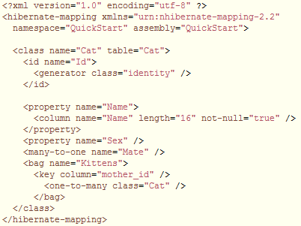
Internal DSLs - examples

Slide 6
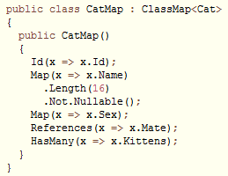
Internal DSLs - examples

Slide 7
External DSL
Language separate from the main language of the application it works with
Custom syntax, common to borrow other syntax
Parsed in the host code using text parsing techniques

Slide 8
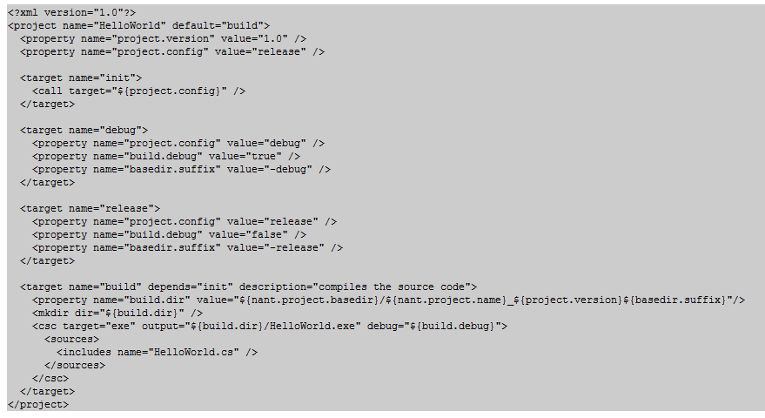
External DSLs - examples

Slide 9
When to use Internal DSLs?
Good for when coders are using the DSL
More static in nature

Slide 10
When to use External DSLs?
Good for when non-coders are using the DSL
Not compiled in to the application
More dynamic/flexible in nature

Slide 11
External DSL Processing
DSL script
Semantic Model
Target Code
Parse
Generate

Slide 12
Parsing
Lexer/Parser tool
yacc
ANTLR
Irony
Language Workbench

Slide 13
Semantic Model - AST
BinaryNode
NumberNode
NumberNode

Slide 14
Generate
Walk the tree manually
Build a C# expression tree
Compile it
Magic

Slide 15
Irony
Internal DSL in C#
Follows standard parsing formats (EBNF)
Used to build parsers for External DSLs

Slide 16
Demo

Slide 17

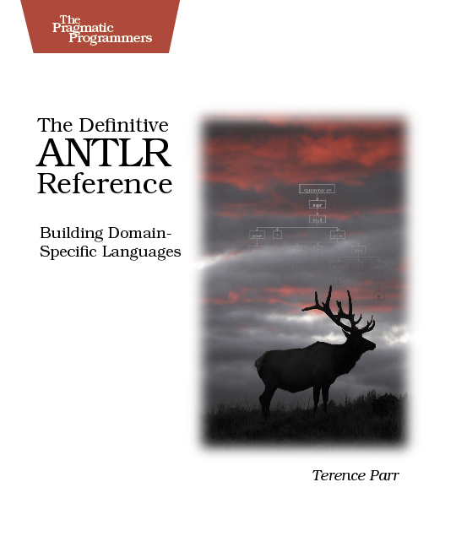
For more info

